Slide 1
Murach’s PHP and MySQL (4th Edition)
Chapter 14
How to create and use objects

Slide 2
Applied objectives
Create and use your own classes, objects, properties, and methods.
Create and use your own class constants, static properties, and static methods.
Create and use your own enums.
Use your own classes and objects to implement the MVC pattern.

Slide 3
Knowledge objectives
Describe the creation of a class including its properties and methods.
Describe the use of the $this variable in a class.
Describe how constructor property promotion works.
Describe the creation of an object from a class and the use of the object’s properties and methods.
Describe the use of class constants and static properties and methods.
Explain how an enum can be used to provide a set of fixed values for an option.
Describe the differences between applications that use procedural techniques for implementing the MVC pattern and those that use object-oriented techniques.
Describe how inheritance works, including how to work with abstract classes and methods, final classes, methods, and constants, and interfaces.

Slide 4
The Category class
class Category {
public function __construct(private int $id,
private string $name) { }
public function getID() {
return $this->id;
}
public function setID(int $value) {
$this->id = $value;
}
public function getName() {
return $this->name;
}
public function setName(string $value) {
$this->name = $value;
}
}

Slide 5
Key terms related to object-oriented programming
object-oriented programming
object
class
property
method
object access operator

Slide 6
The Product class (part 1)
class Product {
private int $id;
public function __construct(
private Category $category,
private string $code,
private string $name,
private float $price, ) {
}
public function getCategory() {
return $this->category;
}
public function setCategory(Category $value) {
$this->category = $value;
}
public function getID() {
return $this->id;
}

Slide 7
The Product class (part 2)
public function setID(int $value) {
$this->id = $value;
}
public function getCode() {
return $this->code;
}
public function setCode(string $value) {
$this->code = $value;
}
public function getName() {
return $this->name;
}
public function setName(string $value) {
$this->name = $value;
}

Slide 8
The Product class (part 3)
public function getPrice() {
return $this->price;
}
public function getPriceFormatted() {
$formatted_price = number_format($this->price, 2);
return $formatted_price;
}
public function setPrice(float $value) {
$this->price = $value;
}
public function getDiscountPercent() {
$discount_percent = 30;
return $discount_percent;
}

Slide 9
The Product class (part 4)
public function getDiscountAmount() {
$discount_percent =
$this->getDiscountPercent() / 100;
$discount_amount =
$this->price * $discount_percent;
$discount_amount_r = round($discount_amount, 2);
$discount_amount_f =
number_format($discount_amount_r, 2);
return $discount_amount_f;
}
public function getDiscountPrice() {
$discount_price =
$this->price - $this->getDiscountAmount();
$discount_price_f =
number_format($discount_price, 2);
return $discount_price_f;
}

Slide 10
The Product class (part 5)
public function getImageFilename() {
$image_filename = $this->code . '.png';
return $image_filename;
}
public function getImagePath() {
$image_path =
'../images/' . $this->getImageFilename();
return $image_path;
}
public function getImageAltText() {
$image_alt = 'Image: ' . $this->getImageFilename();
return $image_alt;
}
}

Slide 11
The syntax for coding a property
[ public | protected | private ] [type] $propertyName [ = initialValue ];
A private property
private $firstName;
A private property with a type declaration (PHP 7.4 and later)
private int $id;
A private property with a nullable type (PHP 7.4 and later)
private ?Category $category;

Slide 12
A public property with a default value
public $comment = '';
A protected property
protected $counter;
Five properties on the same line
private $category, $id, $name, $description, $price;
Two properties with the same type on the same line
private float $price, $discount;
Notes:
public - the property or method can be accessed from everywhere. This is default
protected - the property or method can be accessed within the class and by classes derived from that class
private - the property or method can ONLY be accessed within the class

Slide 13
A read-only property (PHP 8.1 and later)
class Category {
private readonly string $id;
public function __construct(string $id) {
$this->id = $id;
}
}

Slide 14
Key terms related to properties
public property
private property
protected property
scalar value
read-only property

Slide 15
The syntax for coding a constructor method
public function __construct([parameterList]) {
// Statements to execute
}
The default constructor
public function __construct() { }
A constructor for the Category class
public function __construct(int $id, string $name) {
$this->id = $id;
$this->name = $name;
}
The constructor with default values
public function __construct(int $id = 0,
string $name = '') {
$this->id = $id;
$this->name = $name;
}

Slide 16
How to code a destructor method
The syntax
public function __destruct() {
// Statements to execute
}
A destructor for a database class
public function __destruct() {
$this->dbConnection->close();
}

Slide 17
Key terms related to constructors and destructors
constructor method
constructor
destructor method
destructor
object access operator

Slide 18
How to use constructor property promotion
The code for the constructor method
public function __construct( private int $id, private string $name) { }
The private properties that PHP generates
private int $id;
private string $name;

Slide 19
How to use constructor property promotion with default values
The code for the constructor method
public function __construct(
private int $id = 0,
private string $name = '')
{ }
The private properties that PHP generates
private int $id = 0;
private string $name = '';

Slide 20
How to code a read-only property with constructor property promotion
The code for the constructor method
public function __construct(private readonly string $id) { }
The private property that PHP generates
private readonly string $id;

Slide 21
The syntax for coding a method
[public | private | protected]
function functionName ([parameterList]) {
// Statements to execute
}
A public method
public function getSummary() {
$maxLength = 25;
$summary = $this->description;
if (strlen($summary) > $maxLength) {
$summary =
substr($summary, 0, $maxLength - 3) . '...';
}
return $summary;
}

Slide 22
A private method
private function internationalizePrice($country = 'US') {
switch ($country) {
case 'US':
return '$' . number_format($this->price, 2);
case 'FR':
return number_format(
$this->price, 2, ',' , '.') . ' EUR';
default:
return number_format($this->price, 2);
}
}

Slide 23
A method that accesses a property of the current object
public function showDescription() {
echo $this->description;
}
A method that calls a method of the current object
public function showPrice($country = 'US') {
echo $this->internationalizePrice($country);
}

Slide 24
The syntax for creating an object
$objectName = new ClassName(argumentList);
Creating a Category object
$brass = new Category(4, 'Brass');
Creating a Product object
$trumpet = new Product( $brass, 'Getzen', 'Getzen 700SP Trumpet', 999.95);

Slide 25
The syntax for setting a public property value
$objectName->propertyName = value;
The syntax for getting a public property value
$objectName->propertyName;
Setting a property
$trumpet->comment = 'Discontinued';
Getting a property
echo $trumpet->comment;

Slide 26
The syntax for calling an object’s methods
$objectName->methodName(argumentList);
Calling the getFormattedPrice() method
$price = $trumpet->getFormattedPrice();
Object chaining
echo $trumpet->getCategory()->getName(); // Error if category is NULL
How to use the nullsafe operator with object chaining (PHP 8.0 and later)
$id = $trumpet->getCategory()?->getID(); // NULL if category is NULL

Slide 27
Key terms for creating and using objects
instance of a class
instantiation
object chaining
nullsafe operator

Slide 28
The syntax for coding a class constant
[public | private | protected] const CONSTANT_NAME = constantValue;

Slide 29
A class with three class constants
class Person {
public const GREEN_EYES = 1;
public const BLUE_EYES = 2;
public const BROWN_EYES = 3;
private $eye_color;
public function getEyeColor() {
return $this->eye_color;
}
public function setEyeColor($value) {
if ($value == self::GREEN_EYES ||
$value == self::BLUE_EYES ||
$value == self::BROWN_EYES) {
$this->eye_color = $value;
} else {
exit('Eye Color Not Set');
}
}
}

Slide 30
Code that uses the constant outside the class
$person = new Person();
// best practice
$person->setEyeColor(Person::GREEN_EYES);
// works, but is a bad practice
$person->setEyeColor(1);

Slide 31
A class with a private static property and a public static method
class Category {
private static $objectCount = 0;
public function __construct(private $id,
private $name) {
self::$objectCount++;
}
// A public method that gets the static property
public static function getObjectCount(){
return self::$objectCount;
}
// The rest of the methods for the Category class
}

Slide 32
How to use a public static method from outside the class
$guitars = new Category(1, 'Guitars');
$basses = new Category(2, 'Basses');
echo '<p>Object count: ' .
Category::getObjectCount() . '</p>'; // 2
$drums = new Category(3, 'Drums');
echo '<p>Object count: ' .
Category::getObjectCount() . '</p>'; // 3
How to use a public static property from outside the class
echo '<p>Object count: ' . Category::$objectCount . '</p>';
Notes:
Static does not need a class

Slide 33
Key terms related to class definitions
class constant
scope resolution operator
static property
static method
class property
class method

Slide 34
A pure enum with three cases
enum EyeColor {
case Green;
case Blue;
case Brown;
}
An instance of the enum
$color = EyeColor::Green;
Accessing the name property of the enum
echo $color->name // displays Green
Notes:
Enum = fixed set of multiple values

Slide 35
A class with a property of the enum type
class Person {
private EyeColor $eye_color;
public function getEyeColor() {
return $this->eye_color;
}
public function setEyeColor(EyeColor $color) {
$this->eye_color = $color;
}
}
Code that uses the class
$person = new Person();
$person->setEyeColor($color);
$person->setEyeColor(1); // Error - not of type EyeColor

Slide 36
A backed enum with string values
enum EyeColor : string {
case Green = '#008000';
case Blue = '#0000ff';
case Brown = '#a52a2a';
}
A method that uses the backed enum
public function getEyeColorHexValue() {
return $this->eye_color->value;
}

Slide 37
Key terms related to enums
enum
enumeration
pure enum
backed enum

Slide 38
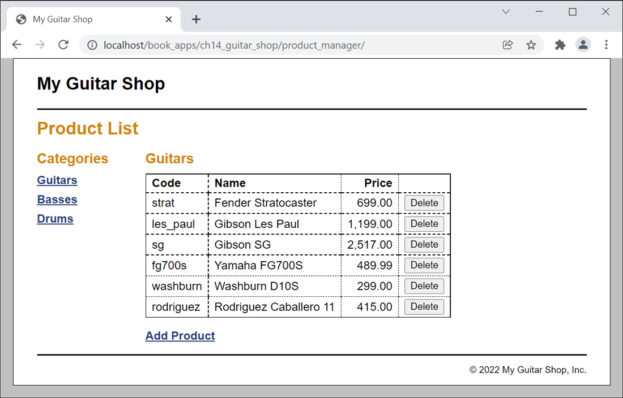
The Product List page

Slide 39
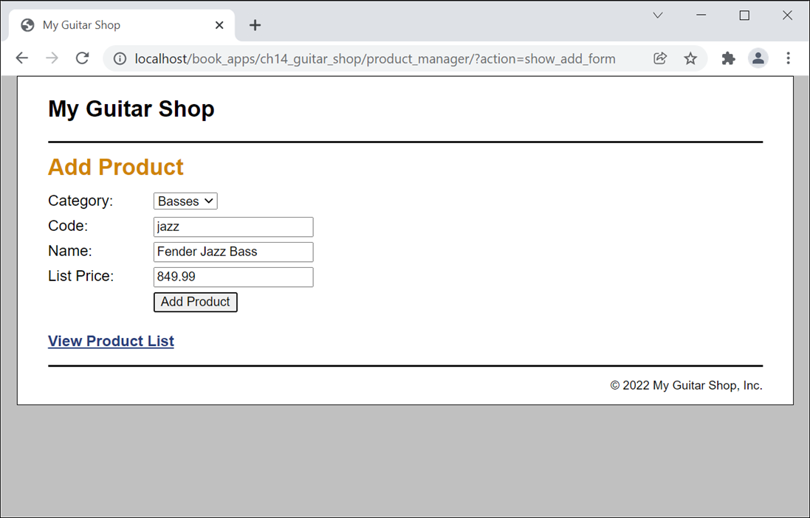
The Add Product page

Slide 40
The database.php file (part 1)
<?php
class Database {
private static $dsn =
'mysql:host=localhost;dbname=my_guitar_shop1';
private static $username = 'mgs_user';
private static $password = 'pa55word';
private static $db;
private function __construct() {}

Slide 41
The database.php file (part 2)
public static function getDB() {
if (!isset(self::$db)) {
try {
self::$db = new PDO(self::$dsn,
self::$username,
self::$password);
} catch (PDOException $e) {
$error_message = $e->getMessage();
include('../errors/database_error.php');
exit();
}
}
return self::$db;
}
}
?>

Slide 42
The product_db.php file (part 1)
<?php
class ProductDB {
public static function getProductsByCategory($category_id) {
$db = Database::getDB();
$category = CategoryDB::getCategory($category_id);
$query = 'SELECT * FROM products
WHERE categoryID = :category_id
ORDER BY productID';
$statement = $db->prepare($query);
$statement->bindValue(":category_id", $category_id);
$statement->execute();
$rows = $statement->fetchAll();
$statement->closeCursor();
foreach ($rows as $row) {
$product = new Product($category,
$row['productCode'],
$row['productName'],
$row['listPrice']);
$product->setId($row['productID']);
$products[] = $product;
}
return $products;
}

Slide 43
The product_db.php file (part 2)
public static function getProduct($product_id) {
$db = Database::getDB();
$query = 'SELECT * FROM products
WHERE productID = :product_id';
$statement = $db->prepare($query);
$statement->bindValue(":product_id", $product_id);
$statement->execute();
$row = $statement->fetch();
$statement->closeCursor();
$category = CategoryDB::getCategory($row['categoryID']);
$product = new Product($category,
$row['productCode'],
$row['productName'],
$row['listPrice']);
$product->setID($row['productID']);
return $product;
}

Slide 44
The product_db.php file (part 3)
public static function deleteProduct($product_id) {
$db = Database::getDB();
$query = 'DELETE FROM products
WHERE productID = :product_id';
$statement = $db->prepare($query);
$statement->bindValue(':product_id', $product_id);
$statement->execute();
$statement->closeCursor();
}

Slide 45
The product_db.php file (part 4)
public static function addProduct($product) {
$db = Database::getDB();
$category_id = $product->getCategory()->getID();
$code = $product->getCode();
$name = $product->getName();
$price = $product->getPrice();
$query = 'INSERT INTO products
(categoryID, productCode, productName, listPrice)
VALUES
(:category_id, :code, :name, :price)';
$statement = $db->prepare($query);
$statement->bindValue(':category_id', $category_id);
$statement->bindValue(':code', $code);
$statement->bindValue(':name', $name);
$statement->bindValue(':price', $price);
$statement->execute();
$statement->closeCursor();
}
}
?>

Slide 46
The index.php file (part 1)
<?php
require('../model/database.php');
require('../model/category.php');
require('../model/category_db.php');
require('../model/product.php');
require('../model/product_db.php');
$action = filter_input(INPUT_POST, 'action');
if ($action == NULL) {
$action = filter_input(INPUT_GET, 'action');
if ($action == NULL) {
$action = 'list_products';
}
}

Slide 47
The index.php file (part 2)
switch($action) {
case 'list_products':
$category_id = filter_input(INPUT_GET, 'category_id',
FILTER_VALIDATE_INT);
if ($category_id == NULL || $category_id == FALSE) {
$category_id = 1;
}
$current_category = CategoryDB::getCategory($category_id);
$categories = CategoryDB::getCategories();
$products = ProductDB::getProductsByCategory($category_id);
include('product_list.php');
break;
case 'delete_product':
$product_id = filter_input(INPUT_POST, 'product_id',
FILTER_VALIDATE_INT);
$category_id = filter_input(INPUT_POST, 'category_id',
FILTER_VALIDATE_INT);
ProductDB::deleteProduct($product_id);
header("Location: .?category_id=$category_id");
break;
case 'show_add_form':
$categories = CategoryDB::getCategories();
include('product_add.php');
break;

Slide 48
The index.php file (part 3)
case 'add_product':
$category_id = filter_input(INPUT_POST, 'category_id',
FILTER_VALIDATE_INT);
$code = filter_input(INPUT_POST, 'code');
$name = filter_input(INPUT_POST, 'name');
$price = filter_input(INPUT_POST, 'price',
FILTER_VALIDATE_FLOAT);
if ($category_id == NULL || $category_id == FALSE ||
$code == NULL || $name == NULL || $price == NULL ||
$price == FALSE) {
$error = "Invalid product data. Check all fields " .
"and try again.";
include('../errors/error.php');
} else {
$current_category =
CategoryDB::getCategory($category_id);
$product = new Product($current_category, $code,
$name, $price);
ProductDB::addProduct($product);
header("Location: .?category_id=$category_id");
}
break;
}
?>

Slide 49
The product_list.php file (part 1)
<?php include '../view/header.php'; ?>
<main>
<h1>Product List</h1>
<aside>
<!-- display a list of categories -->
<h2>Categories</h2>
<nav>
<ul>
<?php foreach ($categories as $category) : ?>
<li>
<a href="?category_id=<?php
echo $category->getID(); ?>">
<?php echo $category->getName(); ?>
</a>
</li>
<?php endforeach; ?>
</ul>
</nav>
</aside>

Slide 50
The product_list.php file (part 2)
<section>
<!-- display a table of products -->
<h2><?php echo $current_category->getName(); ?></h2>
<table>
<tr>
<th>Code</th>
<th>Name</th>
<th class="right">Price</th>
<th>&nbsp;</th>
</tr>
<?php foreach ($products as $product) : ?>
<tr>
<td><?php echo $product->getCode(); ?></td>
<td><?php echo $product->getName(); ?></td>
<td class="right"><?php echo
$product->getPriceFormatted(); ?>
</td>

Slide 51
The product_list.php file (part 3)
<td><form action="." method="post"
id="delete_product_form">
<input type="hidden" name="action"
value="delete_product">
<input type="hidden" name="product_id"
value="<?php echo $product->getID(); ?>">
<input type="hidden" name="category_id"
value="<?php echo
$current_category->getID(); ?>">
<input type="submit" value="Delete">
</form></td>
</tr>
<?php endforeach; ?>
</table>
<p><a href="?action=show_add_form">Add Product</a></p>
</section>
</main>
<?php include '../view/footer.php'; ?>

Slide 52
The syntax for looping through an object’s properties
foreach($objectName as
[ $propertyName => ] $propertyValue) {
// statements to execute
}

Slide 53
An Employee class
class Employee {
private $ssn;
private $dob;
public function __construct(public $firstName,
public $lastName) { }
// getSSN, setSSN, getDOB, setDOB methods not shown
// Show properties – private, protected, and public
public function showAll() {
echo '<p>';
foreach($this as $name => $value ) {
echo "$name = $value | ";
}
echo '</p>';
}
}

Slide 54
An Employee object with four properties
$employee = new Employee('John', 'Doe');
$employee->setSSN('999-14-3456');
$employee->setDOB('3-15-1970');
Show all properties
$employee->showAll();
Show public properties only
echo '<p>';
foreach($employee as $name => $value ) {
echo "$name = $value | ";
}
echo '</p>';

Slide 55
The syntax for cloning an object
clone $objectName
An object to clone
$brass = new Category(4, 'Brass');
$trumpet = new Product($brass, 'Getzen', 'Getzen 700SP Trumpet', 999.95);
Create a second reference to an object
$trombone = $trumpet;
// both variables refer to the same object
$trombone->setPrice(699.95);
// changes the price for both variables

Slide 56
Create a clone of an object
$trombone = clone $trumpet;
// copy the object
$trombone->setPrice(899.95);
// only changes the price for trombone
The copies are shallow copies
$trombone->getCategory()->setName('Orchestral Brass');
echo $trumpet->getCategory()->getName(); // Displays 'Orchestral Brass’

Slide 57
Using the == operator to compare objects
$result_1 = ($trumpet == $trombone); // $result_1 is FALSE
$flugelhorn = clone $trumpet;
$result_2 = ($trumpet == $flugelhorn); // $result_2 is TRUE
Using the === operator to compare objects
$result_3 = ($trumpet === $flugelhorn);
// $result_3 is FALSE
$trumpet_2 = $trumpet;
$result_4 = ($trumpet === $trumpet_2);
// $result_4 is TRUE
$result_5 = ($trumpet->getCategory() ===
$trombone->getCategory());
// $result_5 is TRUE

Slide 58
Key terms related to cloning objects
clone
shallow copy

Slide 59
Functions for inspecting an object
class_exists($class)
get_class($object)
is_a($object, $class)
property_exists($object, $property)
method_exists($object, $method)
Notes:
is_a checks type

Slide 60
Determine if an object is an instance of a class
if (is_a($trumpet, 'Product')) {
// Code to work with a Product object
}
Determine if an object has a property
if (property_exists($trumpet, 'price')) {
// Code to work with the price property
}
Determine if an object has a method
if (method_exists($trumpet, 'getPrice')) {
// Code to work with the getPrice method
}

Slide 61
Syntax for inspecting an object (PHP 8.0 and later)
$object::class
Get the name of the class of an object instance
$class_name = get_class($trumpet); // Product
$class_name = $trumpet::class; // Product

Slide 62
Key terms for inspecting an object
introspection
Reflection https://www.php.net/manual/en/intro.reflection.php
Notes:
Introspection = examine an objects characteristics reflection = manipilute characteristics

Slide 63
A superclass
class Person {
private $phone, $email;
public function __construct(private $firstName,
private $lastName) { }
public function getFirstName() {
return $this->firstName; }
public function setFirstName($value) {
$this->firstName = $value; }
public function getLastName() {
return $this->lastName; }
public function setLastName($value) {
$this->lastName = $value; }
public function getPhone() { return $this->phone; }
public function setPhone($value) {
$this->phone = $value; }
public function getEmail() { return $this->email; }
public function setEmail($value) {
$this->email = $value; }
}

Slide 64
A subclass
class Employee extends Person {
public function __construct(
$first, $last, // pass to superclass
private $ssn, // promoted subclass property
private $hireDate) // promoted subclass property
{
// Finish initialization
parent::__construct($first, $last);
}
public function getSSN() { return $this->ssn; }
public function setSSN($value) {
$this->ssn = $value; }
public function getHireDate() {
return $this->hireDate; }
public function setHireDate($value) {
$this->hireDate = $value; }
}

Slide 65
Code that uses the subclass
$emp = new Employee(
'John', 'Doe', '999-14-3456', '8-25-1996');
$emp->setPhone('919-555-4321'); // Inherited from Person class

Slide 66
Key terms related to inheritance
inheritance
inherit
subclass, derived class, child class
superclass, base class, parent class
extend a superclass
override a method of a superclass

Slide 67
How the access modifiers work
Modifier | Access outside class? | Access from subclass?
public | Yes | Yes
protected | No | Yes
private | No | No

Slide 68
A superclass with protected access modifiers
class Person {
private $phone, $email;
public function __construct(
protected $firstName, protected $lastName) { }
// get and set methods
}
A subclass
class Employee extends Person {
// constructor and get and set methods
// This method uses the protected properties // from the Person class
public function getFullName() {
return $this->lastName . ', ' . $this->firstName;
}
}

Slide 69
An abstract class with an abstract method
abstract class Person {
private $phone, $email;
// constructor and get and set methods
// An abstract method
abstract public function getFullName();
}

Slide 70
Implementing an abstract class (part 1)
class Customer extends Person {
private $cardNumber, $cardType;
public function __construct(
$first, $last, $phone, $email) {
$this->setPhone($phone);
$this->setEmail($email);
parent::__construct($first, $last);
}
public function getCardNumber() {
return $this->cardNumber; }
public function setCardNumber($value) {
$this->cardNumber = $value; }
public function getCardType() {
return $this->cardType; }
public function setCardType($value) {
$this->cardType = $value; }

Slide 71
Implementing an abstract class (part 2)
// Concrete implementation of the abstract method
public function getFullName() {
return $this->getFirstName() . ' ' .
$this->getLastName();
}
}

Slide 72
Code that attempts to create an object from the abstract class
$customer = new Person('John', 'Doe'); // Fatal error
Code that creates and uses an object from the concrete class
$customer = new Customer(
'John', 'Doe', '919-555-4321', 'jdoe@example.com');
echo '<p>' . $customer->getFullName() . '</p>';
Notes:
Abstract class – define other class – cannot be instantiated concrete = fully implemented

Slide 73
Key terms related to abstract classes
abstract class
abstract method
concrete class

Slide 74
A class with a final method
class Person {
// Other properties and methods not shown here
final public function getFirstName() {
return $this->firstName;
}
}
A subclass that tries to override the final method
class Employee extends Person {
// Other properties and methods not shown here
// Attempt to override a final method - fatal error
public function getFirstName() {
return ucwords($this->firstName);
}
}
Notes:
Final = cannot be inherited or overridden

Slide 75
A final class that can’t be inherited
final class Employee extends Person {
// Properties and methods for class
}
A class that attempts to inherit the final class
// Causes fatal error
class PartTime extends Employee {
// Properties and methods for class
}

Slide 76
A class with a final constant (PHP 8.1 and later)
class Person {
// Other properties and methods not shown here
final public const SPECIES = 'Homo sapien';
}
A subclass that attempts to override the final constant
class Employee extends Person {
// Other properties and methods not shown here
// Attempt to override a final constant - fatal error
public const SPECIES = 'Robot';
}

Slide 77
The syntax for an interface
interface interfaceName {
public const constantName = constantValue;
public function methodName( parameterList );
}
An interface with one method
interface Showable {
public function show();
}
An interface with one constant and one method
interface Testable {
public const NAME = "Testable";
public function test($value1);
}

Slide 78
A class that inherits a class and implements an interface
class Employee extends Person implements Showable {
// Implement the Showable interface
public function show() {
echo 'First Name: ' .
$this->getFirstName() . '<br>';
echo 'Last Name: ' .
$this->getLastName() . '<br>';
}
}
A class declaration that implements two interfaces
class Customer extends Person implements Showable, Testable {...}

Slide 79
A function that accepts any object that implements the Showable interface
function display(Showable $object) { $object->show(); }

Slide 80
A function with an intersection type parameter (PHP 8.1 and later)
function run_test(Showable&Testable $object) {...}
Error if the argument doesn’t implement the interfaces
TypeError: Argument #1 must be of type Showable&Testable, Employee given
Notes:
Intersection = must be frominterface

Slide 81
Key terms related to interfaces
interface
implementing an interface
intersection type

